Slide 1
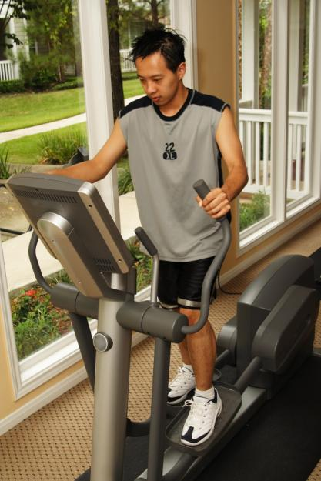
3-10 THE SIMPLE PRESENT: YES/NO QUESTIONS
Does he exercise?

Slide 2
3-10 THE SIMPLE PRESENT: YES/NO QUESTIONS
DO/ + SUBJECT + MAIN
DOES VERB
(b) Do you like salad?
(c) Do we like salad?
(d) Do they like salad?
(a) Do I like salad?
QUESTION FORMS, SIMPLE PRESENT
Do you + main verb
(simple form)
Do we + main verb
(simple form)
Do they + main verb
(simple form)
Do I + main verb
(simple form)

Slide 3
3-10 THE SIMPLE PRESENT: YES/NO QUESTIONS
DO/ + SUBJECT + MAIN
DOES VERB
(g) Does it look good?
(e) Does she like salad?
(f) Does he like salad?
QUESTION FORMS, SIMPLE PRESENT
Does it + main verb
(simple form)
Does she + main verb
(simple form)
Does he + main verb
(simple form)

Slide 4
3-10 THE SIMPLE PRESENT: YES/NO QUESTIONS
(h) Are you a student?
NOT: Do you be a student?
main verb = a form of be
do

Slide 5
3-10 THE SIMPLE PRESENT: YES/NO QUESTIONS
QUESTION SHORT ANSWER
(i) Do you like ice cream?
Yes, I do.
No, I don’t.
(j) Does Max like ice cream?
Yes, he does.
No, he doesn’t.

Slide 6
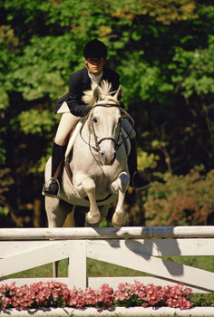
3-10 Let’s Practice
Question
Do you like to ride horses?
Short Answer
Yes, I do.
Long Answer
Yes, I like to ride horses.

Slide 7
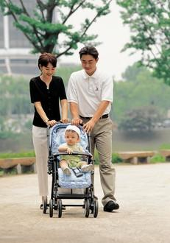
3-10 Let’s Practice
Question
Do they have a baby?
Short Answer
Yes, they do.
Long Answer
Yes, they have a baby.

Slide 8
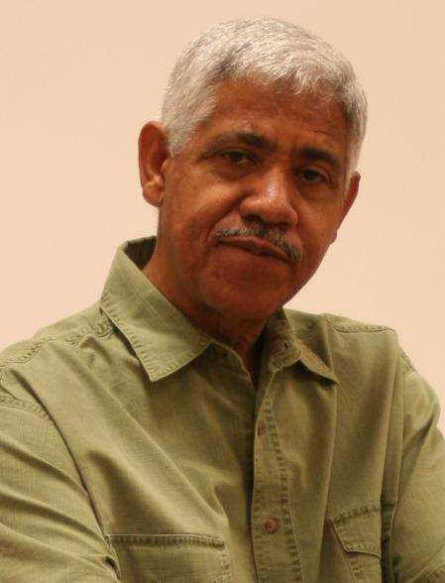
3-10 Let’s Practice
Question
Does Gerardo teach math?
Short Answer
Yes, he does.
Long Answer
Yes, Gerardo teaches math.

Slide 9
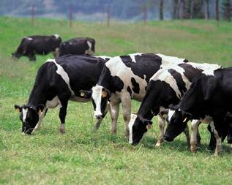
3-10 Let’s Practice
Question
Do cows bark?
Short Answer
No, they don’t.
Long Answer
No, cows don’t bark.

Slide 10
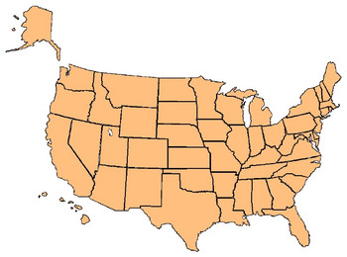
3-11 THE SIMPLE PRESENT: ASKING INFORMATION
QUESTIONS WITH WHERE
Do they live in Baltimore?
*

Slide 11
3-11 THE SIMPLE PRESENT: ASKING INFORMATION
QUESTIONS WITH WHERE
QUESTION SHORT ANSWER
(a) Do they live in Baltimore?
Yes, they do.
No, they don’t.

Slide 12
3-11 THE SIMPLE PRESENT: ASKING INFORMATION
QUESTIONS WITH WHERE
QUESTION SHORT ANSWER
(c) Does Alexi live in Moscow?
Yes, he does.
No, he doesn’t.

Slide 13
3-11 THE SIMPLE PRESENT: ASKING INFORMATION
QUESTIONS WITH WHERE
DO/DOES
+
SUBJECT
+
MAIN VERB
(a) in Baltimore
Do
they
live
?
(c) in Moscow
Does
Alexi
live
?

Slide 14
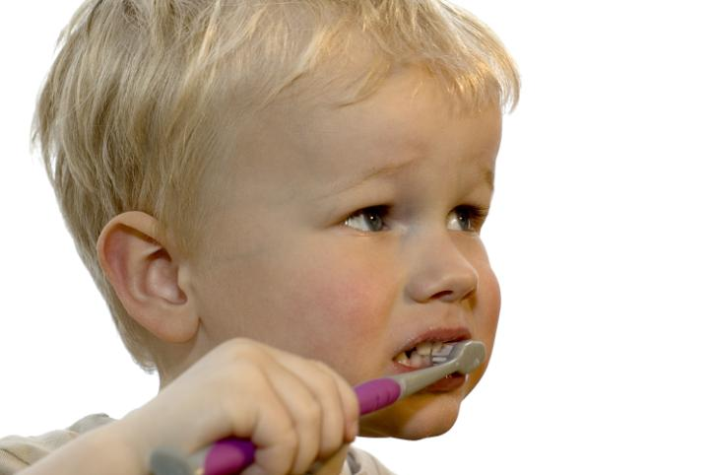
3-11 Let’s Practice
Question:
Answer: Yes, he does.
(The child has a toothbrush.)
Does the child have a toothbrush?

Slide 15
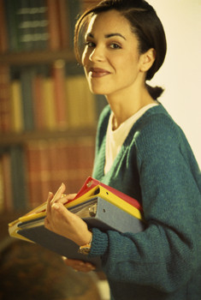
3-11 Let’s Practice
Question:
Answer: Yes, she does.
Does Lucy like to read at the library?
(Lucy likes to read at the library.)

Slide 16
Yes / No Questions Simple Present
Basic 02 – Unit 5b

Slide 17
wash play have cook sleep drink work study
Maria ____ milk and bread for breakfast.
In Germany, people ______ beer in Oktoberfest.
Your father _____ in that office.
Juan and Pedro ______ basketball in the morning
My cat ________ in my bedroom.
I _______ the dishes in the morning.
Fatima _______ lunch for her family.
Reza and I _______ at Ricardo Palma University.

Slide 18
Yes/No questions in English
Does
sing?
Tongo
Yes, he does. Tongo sings.
Does
Mario Vargas Llosa
write songs?
No, he doesn’t. Mario Vargas Llosa writes novels.
Does
your brother
work at ICPNA?
No, he doesn‘t. He studies at ICPNA

Slide 19
Yes/No questions in English
Do
you
study?
Yes, I do. I am study.
Yes, I do. I study.
Do
you
like lasagna?
No, I don’t. I don’t like pasta.
Do
you
speak Italian?
Yes, I do. I speak Italian and ________
No, I don’t. I speak Spanish only.

Slide 20
1. _______________________________?
Yes, I do. I study at ICPNA.
2. __________________________?
No, I don’t. I work at Apple.
3. _________________________?
Yes, he does. He chicken and rice for lunch.
4. _______________________?
Yes, she does. Rihanna sings pop music.
5. __________________________?
No, they don’t. They run in the mornings
6. Do you write poems?
_________________________
7. Does Peru have a President?
_________________________
8. Do you smoke?
_________________________
9. Does your father drink soda?
________________________
10. Do you like chocolate ice cream?
_______________________

Slide 21
1. Work
2. Study
3. Eat eggs for breakfast.
4. Eat cereal for lunch
5. Play volleyball
6. Do homework
7. Talk on the phone a lot

